Slide 1
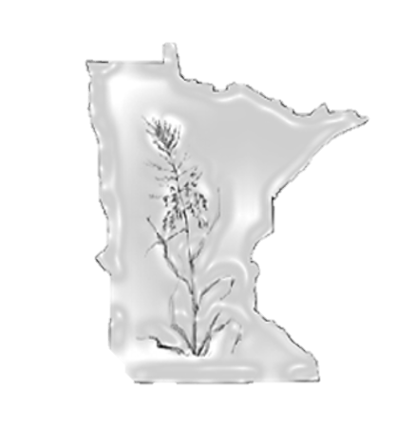

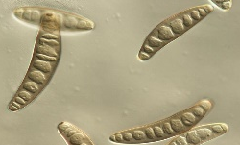
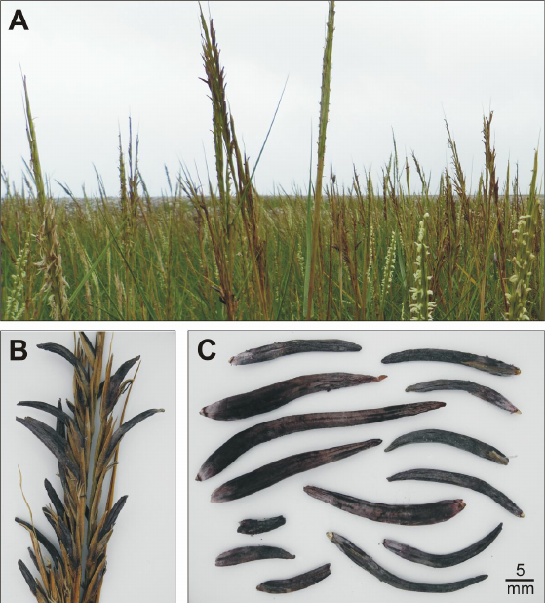
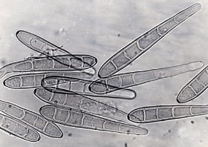
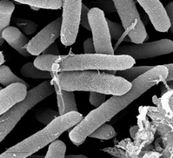
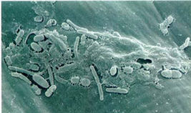
Diseases of Northern Wild Rice
Disease epidemics in cultivated paddies can cause extreme yield reductions up to 67%¹. The main form of control is the application of pesticides. Historically, breeding efforts to develop new disease resistance cultivars has been limited.
Fungal Diseases
Fungal Brown Spot
Spot Blotch
Pathogen: Bipolaris oryzae
Pathogen: Bipolaris sorokiniana
Necrotic brown lesion
Coalescing lesions
Circular, necrotic lesion
Yellow halo
Eye Spot
Ergot
Pathogen: Drechslera gigantea
Pathogen: Claviceps zizaniae
Well-defined margins
Eye shaped lesion
Kernels fill with fungal resting structures (sclerotia)
Water soaking
Bacterial Diseases
Bacterial Brown Spot
Bacterial Leaf Streak
Pathogen: Pseudomonas syringae
Pathogen: Xanthomonas campestris
Dark, narrow lesion
Water soaking
Bacterial ooze
Long, necrotic streak
Translucent slit
Water soaking
© Copyright 2020 by
Dr. Jennifer Kimball
jkimball@umn.edu

